Slide 1

POST GRADUATE TEACHING DEPARTMENT OF STATISTICS , RTMNU NAGPUR.
Project On
Analysis Of 4000 YouTube Channels.
M.Sc. Statistics Sem IV By
Supervisor : Dr. N M Wazalwar. Ms. Vaishnavi Mule
Co – Supervisor : Ms. Latika Lakhade.

Slide 2
Contents:
Purposed Behind Selecting This topic
Data
Introduction
Objective
Tools
Software Used
EDA
Multiple Regression Analysis
Correlation
Conclusion
Reference

Slide 3
Purpose Behind Selecting This Topic:
Social networking is very widely used platform. For example Facebook , instagram , wechat , you tube.
YouTube is one of the very highly used application. For such widely use application the data must also be very large. And statistics is all about dealing with the infinite numbers.
That’s why we take the 4000 YouTube channels for analysis. the data is taken from the well known website known as socialblade.com

Slide 4
Data
Rank | Grade | User Name | Uploads | Subscribers | Video Views
1st | A++ | T-Series | 13,196 | 89,260,189 | 64,519,654,989
2nd | A++ | SET India | 29,564 | 43,556,189 | 30,293,930,936
3rd | A++ | Cocomelon - Nursery Rhymes | 406 | 39,897,550 | 22,450,729,174
4th | A++ | Zee TV | 59,608 | 25,211,521 | 17,879,847,680
5th | A++ | Like Nastya Vlog | 228 | 19,725,297 | 7,659,900,606
6th | A++ | SAB TV | 22,215 | 16,787,530 | 14,327,663,020
7th | A++ | Vlad and Nikita | 94 | 16,584,085 | 5,532,232,881
8th | A++ | ABS-CBN Entertainment | 115,538 | 16,549,236 | 22,162,604,862
9th | A++ | Ch3Thailand | 56,846 | 15,751,433 | 11,735,964,093
10th | A+ | 5-Minute Crafts | 2,826 | 51,558,138 | 12,735,197,195
11th | A+ | Canal KondZilla | 990 | 47,596,784 | 23,558,692,811
12th | A+ | WWE | 40,138 | 40,637,299 | 30,623,485,820
13th | A+ | Badabun | 3,842 | 37,292,948 | 10,714,736,504
14th | A+ | Zee Music Company | 3,980 | 32,745,507 | 15,382,624,256
15th | A+ | Movieclips | 31,891 | 23,692,669 | 21,390,074,680
16th | A+ | Wave Music | 17,410 | 22,513,550 | 14,850,029,470
17th | A+ | GR6 EXPLODE | 2,766 | 22,297,929 | 10,372,882,578
18th | A+ | WorkpointOfficial | 30,489 | 22,003,727 | 17,610,313,289
19th | A+ | Speed Records | 6,665 | 21,451,193 | 10,650,985,351
20th | A+ | ???? ? ??????? | 602 | 20,242,650 | 18,613,138,542

Slide 5

Introduction:
YouTube was created by PayPal employees as a video-sharing website where users could upload, share and view content.
The Internet domain name "www.youtube.com" was activated on Monday, February 14, 2005, at 9:13p.m.
YouTube is an American video-sharing website headquartered in San Bruno, California .
Three former PayPal employees—Chad Hurley , Steve Chen , and Jawed Karim —created the service in February 2005.
YouTube allows users to upload, view, rate, share, add to playlists, report, comment on videos, and subscribe to other users.
YouTube was founded by Chad Hurley, Steve Chen, and Jawed Karim, who were all early employees of PayPal.

Slide 6

From left to right: Chad Hurley , Steve Chen and Jawed Karim, the founders of YouTube
Hurley had studied design at Indiana University of Pennsylvania, and Chen and Karim studied computer science together at the University of Illinois at Urbana–Champaign.
According to a story that has often been repeated in the media, Hurley and Chen developed the idea for YouTube during the early months of 2005.
After they had experienced difficulty sharing videos that had been shot at a dinner party at Chen's apartment in San Francisco.
Karim did not attend the party and denied that it had occurred, but Chen commented that the idea that YouTube was founded after a dinner party "was probably very strengthened by marketing ideas around creating a story that was very digestible".

Slide 7
Karim said the inspiration for YouTube first came from Janet Jackson's role in the 2004 Super Bowl incident, when her breast was exposed during her performance, and later from the 2004 Indian Ocean tsunami.
Karim could not easily find video clips of either event online, which led to the idea of a video sharing site.
Hurley and Chen said that the original idea for YouTube was a video version of an online dating service,and had been influenced by the website Hot or Not.
Difficulty in finding enough dating videos led to a change of plans, with the site's founders deciding to accept uploads of any type of video.

Slide 8
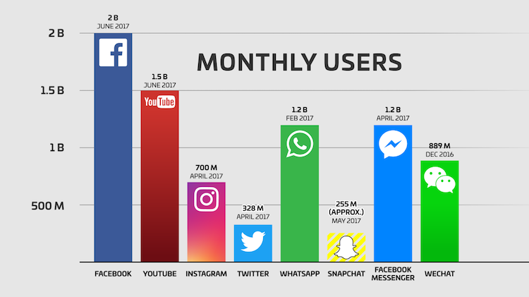
YouTube monthly worldwide active users vs. top social platforms, in millions

Slide 9
Objective
Which YouTube channel have most viewers, Subscribers etc.?
Does more video upload gives out the more video views and more subscribers?
Does more Subscribers gives more video views?
Is there a way to predict the number of subscribers based on the no. of video uploads by the channel and number of video views on it?
Is our data normally fitted?
What is relation between the variable?

Slide 10
Software Used:
R Programming Language
SPSS
Microsoft Excel

Slide 11

Programming Language:
R is a programming language and free software environment for statistical
Computing and graphics supported by the R Foundation for Statistical Computing.
The R language is widely used among statisticians and data miners for developing statistical software and data analysis.
Polls, data mining surveys, and studies of scholarly literature databases show substantial increases in popularity in recent years.
A GNU package, source code for the R software environment is written primarily in C, Fortran and R itself, and is freely available under the GNU General Public License. Pre-compiled binary versions are provided for various operating systems.
Although R has a command line interface, there are several graphical user interfaces, such as RStudio, an integrated development environment.

Slide 12
R is an interpreted language.
Users typically access it through a command-line interpreter.
If a user types 2+2 at the R command prompt and presses enter, the computer replies with 4, as shown below:
>2+2
[1] 4
This calculation is interpreted as the sum of two single-element vectors, resulting in a single-element vector.
The prefix [1] indicates that the list of elements following it on the same line starts with the first element of the vector (a feature that is useful when the output extends over multiple lines).
R's data structures include vectors, matrices, arrays, data frames and lists.
Arrays are stored in column-major order.
R's extensible object system includes objects for (among others): regression models, time-series and geo-spatial coordinates. The scalar data type was never a data structure of R.
Instead, a scalar is represented as a vector with length one.

Slide 13

SPSS:
SPSS is a software package used for interactive or batched, statistical Analysis. it was acquired by IBM in 2009.
The current versions (2015) are named IBM SPSS Statistics.
The software name originally stood for Statistical Package for the Social Sciences (SPSS), reflecting the original market.
The software is now popular in other fields as well, including the health sciences and marketing.
It is also used by market researchers, health researchers, survey companies, government, education researchers, marketing organizations, data miners, and others.
It gives result of regression, advanced statistics and many more.
Create publication ready charts, tables, and decision trees in one tool.
The graphical user interface has two views which can be toggled by clicking on one of the two tabs in the bottom left of the SPSS Statistics window.
The 'Data View' shows a spread sheet view of the cases (rows) and variables (columns).
This gave good interactive response time for the SPSS, Conversational Statistical System (SCSS), whose strong point, as with SPSS, was Cross-tabulation.

Slide 14

Microsoft Excel:
Microsoft Excel is a spared sheet developed by Microsoft by windows macOS, Android and iOS
It features calculation, graphing tools, pivot tables, and a macro programming language called Visual Basic for Applications.
It has been a very widely applied spread sheet for these platforms, especially since version 5 in 1993, and it has replaced Lotus 1-2-3 as the industry standard for spread sheets.
Excel forms part of the Microsoft Office suite of software. Microsoft Excel has the basic features of all spread sheets, using a grid of cells arranged in numbered rows and letter-named columns to organize data manipulations like arithmetic operations.
It has a battery of supplied functions to answer statistical, engineering and financial needs.
In addition, it can display data as line graphs, histograms and charts, and with a very limited three-dimensional graphical display.
From its first version Excel supported end user programming of macros (automation of repetitive tasks) and user defined functions (extension of Excel's built-in function library). In early versions of Excel these programs were written in a macro language whose statements had formula syntax and resided in the cells of special purpose macro sheets.

Slide 15
Tools:
EDA
Regression
Co-relation

Slide 16
Exploratory Data Analysis:
In statistics , exploratory data analysis (EDA) is an approach to analyzing data sets to summarize
Their main characteristics , often with visual methods
A statistical model can be used or not, but primarily EDA is for seeing what the data can tell us beyond the formal modeling or hypothesis testing task.
Exploratory data analysis was promoted by John Tukey to encourage statistician to explore the data, and possibly formulate hypothesis that could lead to new data collection and experiments.
Technique:
Typical graphical techniques used in EDA are:
Box plot
Histogram
Multi-vari chart
Run chart
Pareto chart
Scatter plot
Stem-and-leaf plot.
Parallel coordinate
Odds ratio
Targeted projection pursuit
.

Slide 17
Here I start with plotting some graph showing top 20 in each kind of classification of the channels. First three are top 20 by their ranking, with their uploads, subscribers and video views are presented. The second three are top 20 based on each of the group themselves.
We are interested to know which you-tube channel have most uploads?

Slide 18

Conclusion:
We found from above graph that ABS-CBN entertainment channel uploads more videos than other. And this channel is uploaded 115538 no. of videos.
Second top channel by uploads with their respective grade is ZEE – TV.
ABS-CBN was formed by the merger of Alto Broadcasting System (ABS) and Chronicle Broadcasting Network (CBN). ABS was founded in 1946 by American electronics engineer James Lindenberg as Bolinao Electronics Corporation (BEC).BABS-CBN is the News Channel .

Slide 19
Now we are interested in which channel have most subscribers?

Slide 20

Conclusion:
From the above plot we conclude that T-series got more subscribers than other channel and total no. of subscribers of T-series is 8, 92, 60, and 189.
Second top channel with respective to subscribers who got 5, 15, 58,138 subscribers is canal-kondzilla.
An Indian music company known as T-Series has been the fastest growing YouTube channel since late 2017. From December 2017, they were getting 100,000 subscribers day after day continously and they were growing four times faster than PewDiePie. Super Cassettes Industries Private Limited, doing business as T-Series, is a music record label and film production company in India founded by Gulshan Kumar .

Slide 21
Here we are interested to find which you tube channel have most video views?

Slide 22
Conclusion:
We can see in above graph that channel “T –series” have most video viewers than any other channel i.e. 64,51,96,54,989. And the second top most channel is WWE and
Vlad – Nikita have minimum video viewers than any other channel.
We see here in graph the most of the channels have no of video viewers In between 0 to 30,000,000,000.

Slide 23
The following three graphs are of 20 maximum to minimum in each class.

Slide 26
Here I am interested how all the channels in the list distribute in terms of subscribers, video uploads, and subscribers going from maximum to minimum in each class. Interestingly there is huge peak at the top list and tend to gain a plateau for the other channel quickly.

Slide 29
Does more video upload gives out the more video views and more subscribers?
Answer:
NO, because
From the first three graph we can see T-series have most subscribers and video views but not have the most uploads.
And also we can say that when we plotted graph of top 20 channels by their grades then we found that the ABS-CBN entertainment channel have most uploads but not subscribers and video views.
Same in further graph it seems that the channel with most uploads is GMA news and with their subscribers is pew-die-pie and with their video views is T- series. So both three channels are different.
So finally we conclude from above discussion that video views and subscribers are not depends upon the no. of video uploads.

Slide 30
Now, we find the count of rank by grades:
Row Labels | Count of Rank
A | 701
A- | 497
A+ | 32
A++ | 9
B | 1105
B+ | 1656
Grand Total | 4000

Slide 31
Classification of the channels by their grades:

Slide 32
Conclusion : the pie chart of no. of channels and grades so we found that the more no. of channels i.e. 41% of channels got B+ grade.
And very few are there who got A++ which is only 0% of our data.
Andin we seem only 1% of channels who got A+ grade.

Slide 33
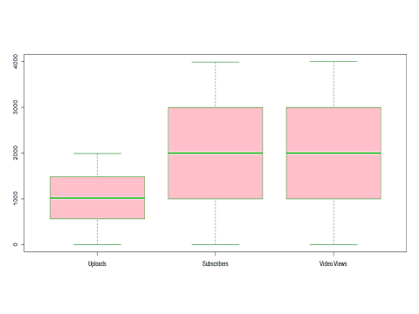
Box Plot:
Now the box plot of our data:
Conclusion:
Here there are three box plot of three variables. (Uploads,Subscribers,Video view). Which shows data is normal as the median lies at the centre.

Slide 34
Box plot:
A box plot is the visual representation of the statistical five number summary of a given data set
2)A five number summary includes:
Minimum
First quartile
Medium
Third quartile
Maximum
3)Mathematician John Tukey first introduce the “Box and Whisker plot” in 1969 as a visiual diagram of the “Five Number Summary” of any given data sets
4)The box plot allows quick graphical examination of one or more data sets
5. Box and Whisker plots have been used steadily since their introduction in 1969 and are varied in
both their potential visualization as well as use cases across many discipline in statistics and data
analysis.
6. Box plot may seem more primitive than a histogram and kernel density estimate but they do
have some advantages. Like they took less space

Slide 35
P-P Plot:
A P–P plot (probability–probability plot or percent –percent plot) is a graphical technique for comparing two data set either two sets are empirical observations, one empirical set against the theoretical sets as two theoretical set against each other.
Model P-P plot is constructed using the theoretical cumulative distribution function f(x) of specified model, it is a plot of empirical cdf values plotted against theoretical cdf value , it is use to determine how well a specific distribution fits to the observe data.
P-P plot mean prob-prob plot or percentile-percentile plot. It is plot for assessing how closely to data sets agree, which plots the two cumulative distribution function against each other.

Slide 36
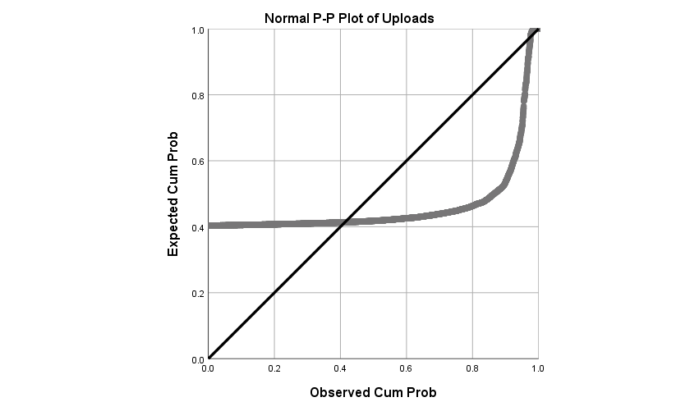
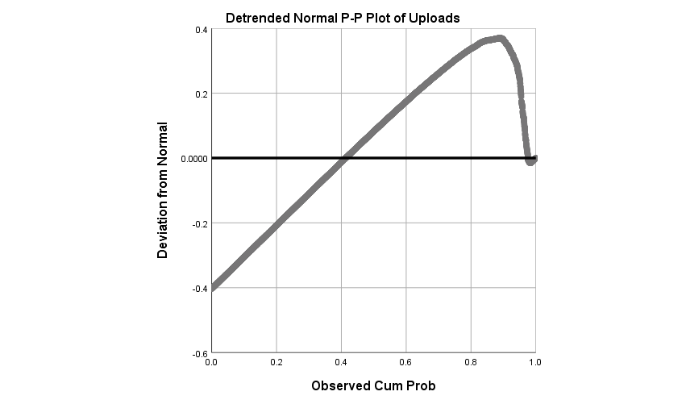
Uploads

Slide 37
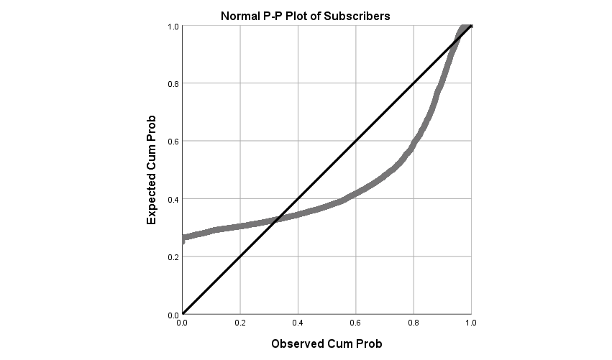
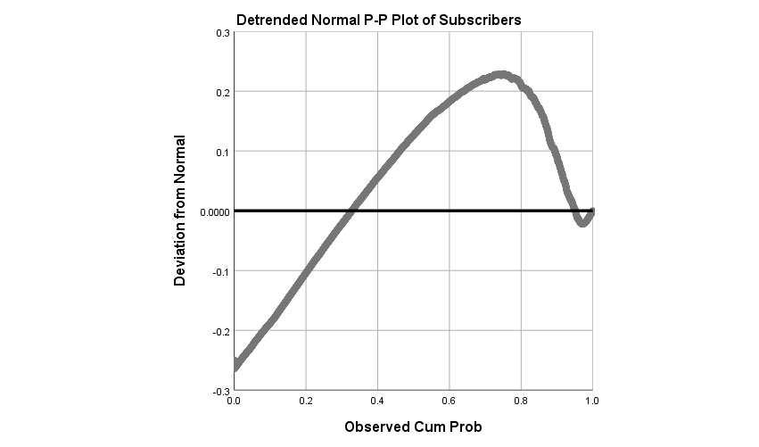
Subscribers

Slide 38
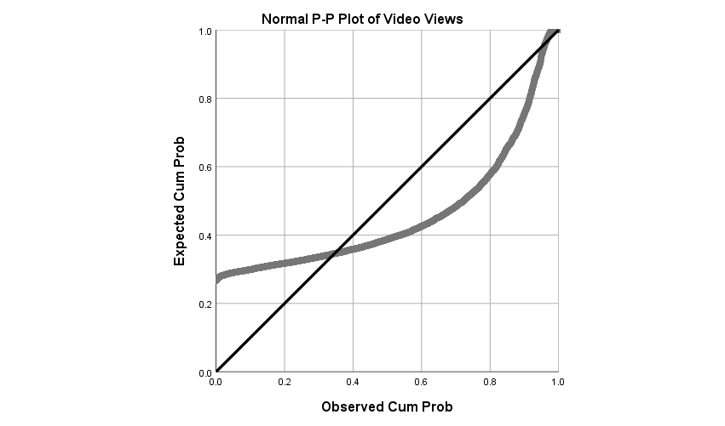

Video Views

Slide 39
QQ Plot
Q-Q PLOT:
A quartile can reffer to dividing prob. Distribution into areas of equal probabilities.
The quntile-quantile plot is a graphical technique for determining if two data sets come from populations with a common distribution.
Applications:
Many distribution ascepts canbe simultaneously tested using Q-Q plot for example shifts in location , shifts in scale , changws in symmetry and presence of outliers can all be detecting from plots.

Slide 40
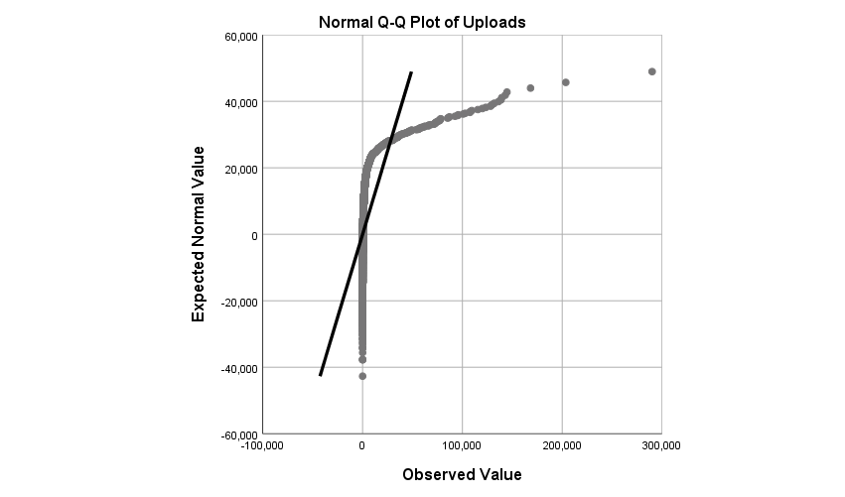
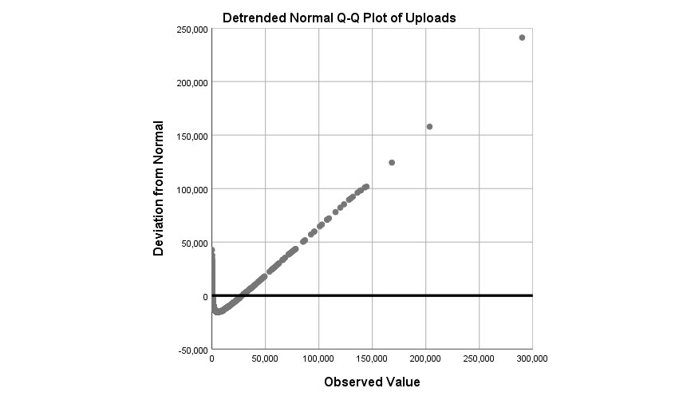
Uploads

Slide 41
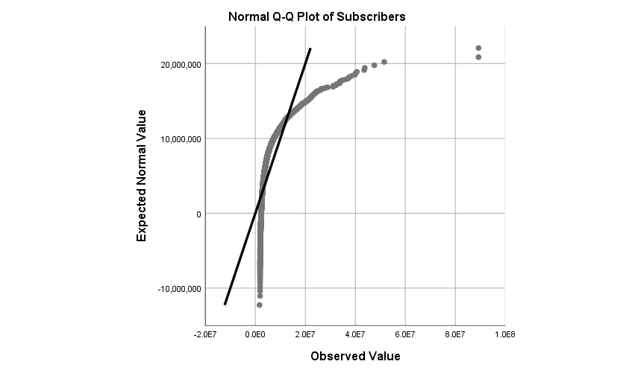
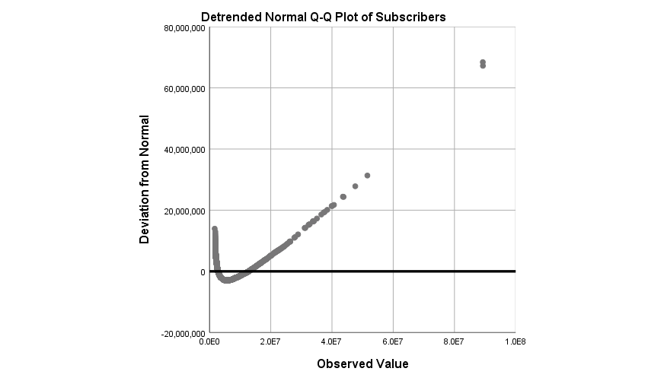
Subscribers

Slide 42
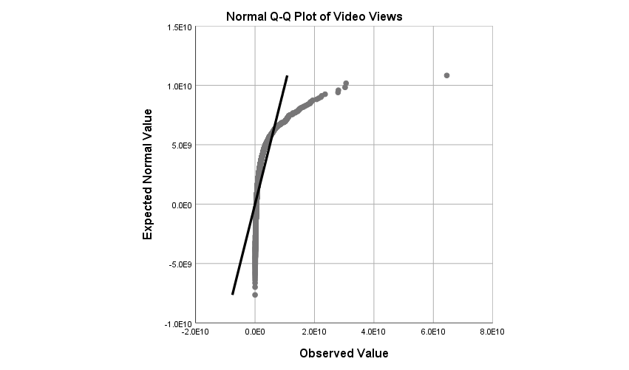
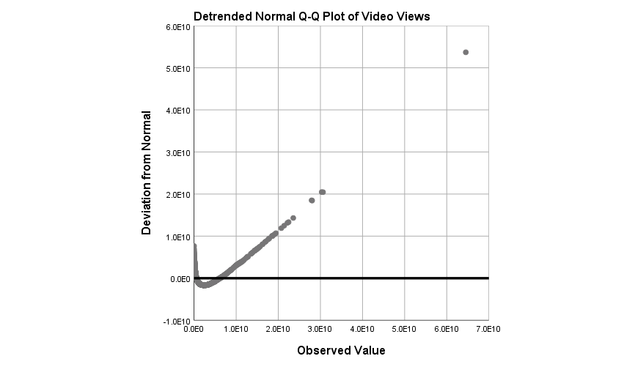
Video Views

Slide 43
Working over the skewness of the data:
From the following three graph, we can see that all three variables are highly positive skewed.

Slide 46
Descriptive statistic:
 | Video uploads | subscribers | Video views
Count | 4000 | 4000 | 4000
Mean | 6248.763309 | 4909195.91 | 1594558314
Std | 197986.8372 | 4763363.94 | 2562633348
min | 1 | 1691906 | 1152052
max | 12500651 | 89287524 | 64519654989
25% | 0.002825853 | 0.06563974 | 0.049916633
50% | 0.001979897 | 0.12119292 | 0.184680396
75% | 0.120407729 | 0.15520859 | 0.360093672
sum | 25001302 | 1.9637E+10 | 6.37823E+12

Slide 47
Multiple Regression Analysis:
Assumptions:
Multiple linear regression requires the relationship between the independent and dependent variables to be linear. The linearity assumption can best be tested with scatterplots. The following two examples depict a curvilinear relationship (left) and a linear relationship (right).
2) The multiple linear regression analysis requires that the errors between observed and predicted values (i.e., the residuals of the regression) should be normally distributed. This assumption may be checked by looking at a histogram or a Q-Q-Plot. Normality can also be checked with a goodness of fit test (e.g., the Kolmogorov-Smirnov test), though this test must be conducted on the residuals themselves.
3) Multiple linear regression assumes that there is no multicollinearity in the data. Multicollinearity occurs when the independent variables are too highly correlated with each other.

Slide 48
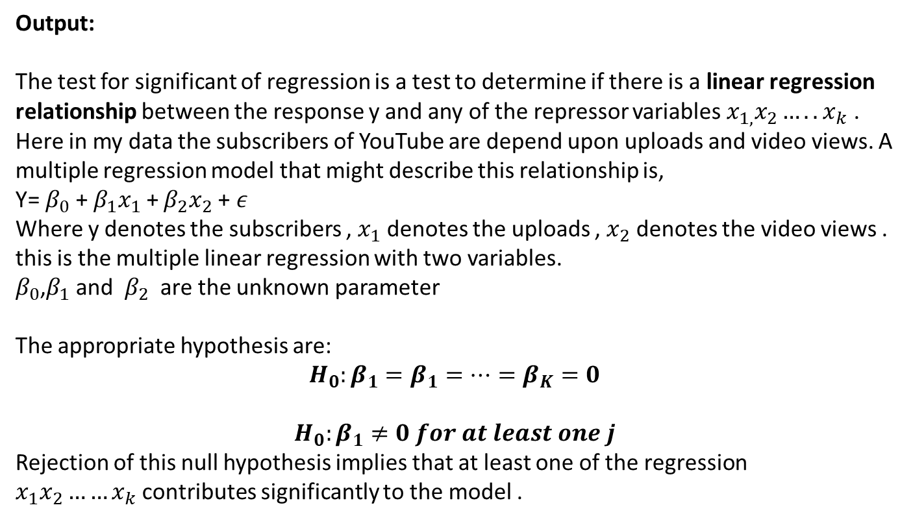
Output:
The test for significant of regression is a test to determine if there is a linear regression relationship between the response y and any of the repressor variables $x_{1,}x_{2}…..x_{k}$ . Here in my data the subscribers of YouTube are depend upon uploads and video views. A multiple regression model that might describe this relationship is,
Y= $β_{0}$ + $β_{1}x_{1}$ + $β_{2}x_{2}$ +$ε$
Where y denotes the subscribers , $x_{1}$ denotes the uploads , $x_{2}$ denotes the video views . this is the multiple linear regression with two variables.
$β_{0}$,$β_{1}$ and $β_{2}$ are the unknown parameter
The appropriate hypothesis are:
$$H_{0}:β_{1}=β_{1}=…=β_{K}=0$$
$$H_{0}:β_{1}≠0 for at least one j$$
Rejection of this null hypothesis implies that at least one of the regression $x_{1}x_{2}……x_{k}$contributes significantly to the model .

Slide 49
The first table of interest is the Model Summary table, as shown below:
Model Summary
Model | R | R Square |  | Adjusted R Square | Std. Error of the Estimate
1 | .723ª | .523 |  | .522 | 3292339.329
a. Predictors: (Constant), Video Views, Uploads
b. Dependent Variable: Subscribers
This table provides the R and R² values. The R value represents the simple correlation and is 0.723, which indicates a high degree of correlation. The R² value indicates how much of the total variation in the dependent variable, Subscribers, can be explained by the independent variable, Video Views, Uploads . In this case, can be explained, which is very large.

Slide 50
The next table is the ANOVA table, which reports how well the regression equation fits the data (i.e., predicts the dependent variable) and is shown below:
ANOVAª
Model |  | Sum of Squares | df | Mean Square | F | Sig.
1 | Regression | 47410380070621456.000 | 2 | 23705190035310728.000 | 2186.927 | .000^{b}
 | Residual | 43325474535180512.000 | 3997 | 10839498257488.244
 | Total | 90735854605801968.000 | 3999
a. Dependent Variable: Subscribers
b. Predictors: (Constant), Video Views, Uploads
This table indicates that the regression model predicts the dependent variable significantly. Here, p < 0.0005, which is less than 0.05, and indicates that, overall, the regression model statistically significantly predicts the outcome variable (i.e., it is a good fit for the data).

Slide 51
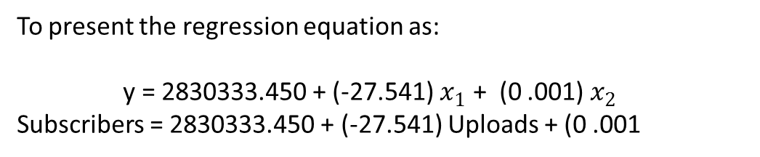
Coefficientsª
Model |  | Unstandardized Coefficients |  | Standardized Coefficients | t | Sig.
 |  | B | Std. Error | Beta
1 | (Constant) | 2830333.450 | 61825.592 |  | 45.779 | .000
 | Uploads | -27.541 | 4.145 | -.073 | -6.644 | .000
 | Video Views | .001 | .000 | .730 | 66.043 | .000
a. Dependent Variable: Subscribers
To present the regression equation as:
y = 2830333.450 + (-27.541) $x_{1}$ + (0 .001) $x_{2}$
Subscribers = 2830333.450 + (-27.541) Uploads + (0 .001

Slide 52
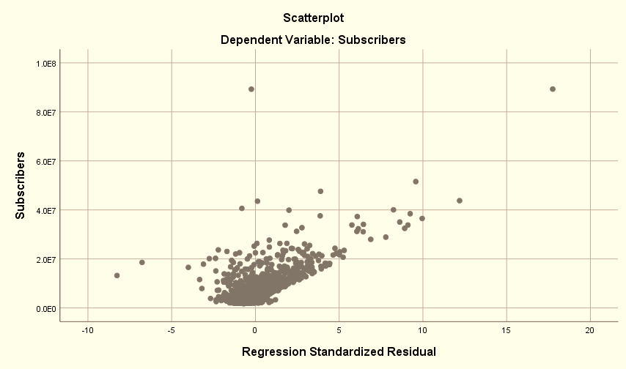
Now , Scatter plot between dependent and predicted values . when we draw straight line through origin , almost points lies along to the straight line but only two points are somehow not in line and that’s why we may say there is two points be an outlier.

Slide 53
The graph is between dependent variable subscribers and their predicted values. This shows there is no much difference in predicted values and dependent value. There is approx two outlier we can detect.

Slide 54
Correlation:
Correlations
 |  | Uploads | Subscribers | Video Views
Uploads | Pearson Correlation | 1 | .038* | .153**
 | Sig. (2-tailed) |  | .016 | .000
 | N | 4000 | 4000 | 4000
Subscribers | Pearson Correlation | .038* | 1 | .719**
 | Sig. (2-tailed) | .016 |  | .000
 | N | 4000 | 4000 | 4000
Video Views | Pearson Correlation | .153** | .719** | 1
 | Sig. (2-tailed) | .000 | .000
 | N | 4000 | 4000 | 4000
*. Correlation is significant at the 0.05 level (2-tailed).
**. Correlation is significant at the 0.01 level (2-tailed).

Slide 55
Conclusion:
We can see that all the three variables are positively correlated. All the correlation coefficients are significant at 5% level of significance, as observed in the above table. The correlation coefficient between video views and subscribers is 0.719, and is highly significant.

Slide 56
Conclusion :
By Explanatory Data Analysis we visualise the data by the different type visualisation graph.
By the Multiple Linear Regression we got that our data fit is good.
By Correlation Coefficient we get the relation between the variable that they all are positively correlated but all are not significant.

Slide 57
Reference
Introduction to Linear Regression Analysis
DOUGLAS C. MONTGOMERY
ELIZABETH A. PECK
Statisticssolution.com

Slide 58
Thank You…….

